Slide 1
Instructor: Youssry Khattab
Bachelor of nuclear engineering , Faculty of engineering, Alexandria University, Nuclear department (2001)
Teaching the following security courses:
CISSP : Certified Information Systems Security Professional
CRISC: Certified in Risk and Information Systems Control
CGEIT: Certified in the Governance of Enterprise IT
CISM : Certified Information Security Manager
CISM: Certified information Security Auditor
ISO-27001 information security management system: ISO 27001 Foundation, ISO 27001 Lead Implementer, ISO 27001 Lead Auditor
ITIL 4 information tech-infrastructure library
EC-Council Certified Ethical Hacker (CEH) , EC-Council Certified system Analyst (ECSA) , EC Council licensed Penetration Tester (LPT)
Computer Hacking and Forensic Investigator (CHFI) , EC-Council Certified Security Specialist (ECSS) , Certified Network Defender (CND)
Microsoft certified system administration (MCSA-2003) and MCSE 2003
Microsoft certified trainer (MCT-2003 to 2023)
Microsoft certified ITP Server Admin , Enterprise administrator (2008)
MS-Certified Solution Associated (MCSA-) , CCNA Switching-routing
MCSE- Server infrastructure , MCSE- Desktop infrastructure , MCSE communication, MCSE- messaging , MCSE-SharePoint , MCSE- private cloud
Teaching the following Linux and Unix courses:
Red Hat Linux Essentials & Red Hat Linux system admin & Red hat Network Services And Security Administration
Unix ---Solaris 10 and 11 Operating (System Essentials & System Administration & Network Administration)
Linux foundation Certified System Admin (LFCSA) , Linux foundation Certified system Engineer (LFCSE)
Teaching the following Microsoft Courses:
  Microsoft TMG 2010
  Microsoft Exchange Server 2007,2010,2013,2016,2019
  Microsoft MCSA 2012 and MCSE 2012 ( private cloud , Messaging , Server infrastructure , Communication )
  Ms System Center 2008 R2 configuration Manager & Data protection Manager 2010
  Ms System Center 2012,2016 ( SCCM , SCVMM ,SCOM ,SCSM )
Teaching the following Virtualization Courses:
VMware VSphere 7 datacenter Virtualization track (VCP-DCV , VCP-NV , VCP-DM)
Citrix XenServer 6 and Administration for Citrix XenApp 6
Red hat Enterprise Virtualization Manager

Slide 2
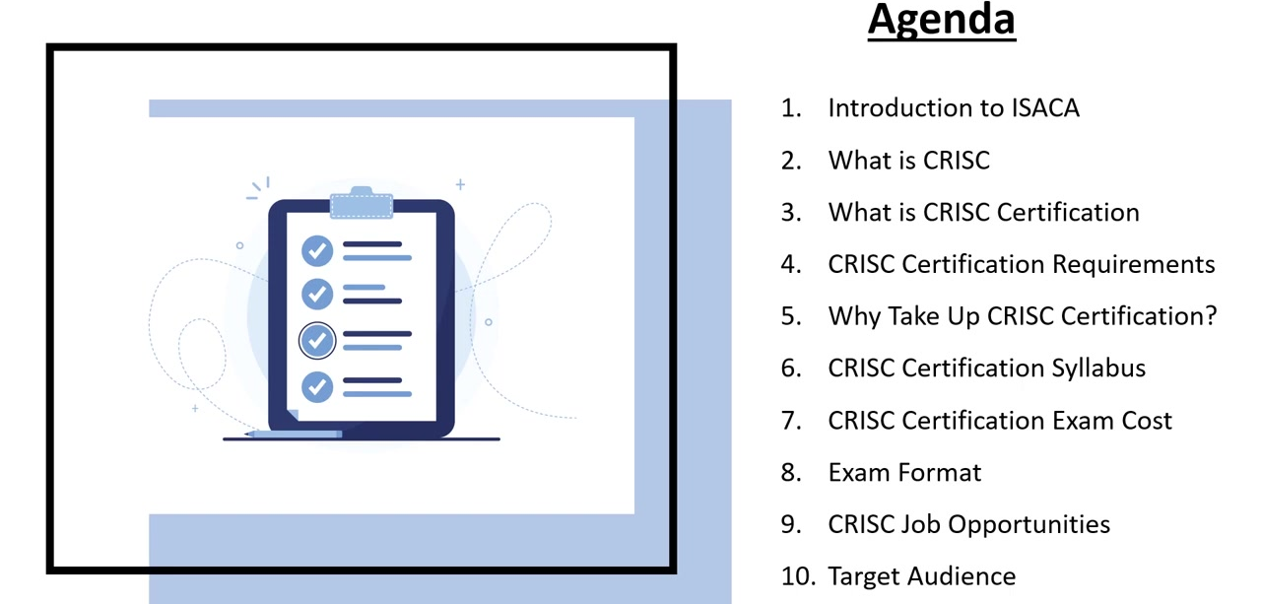

Slide 3
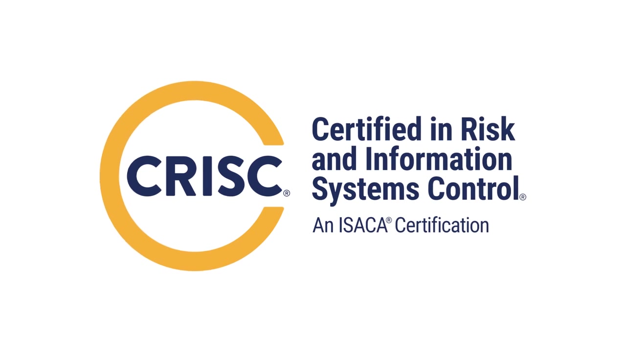

Slide 4
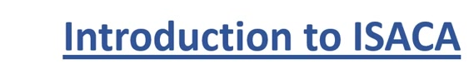
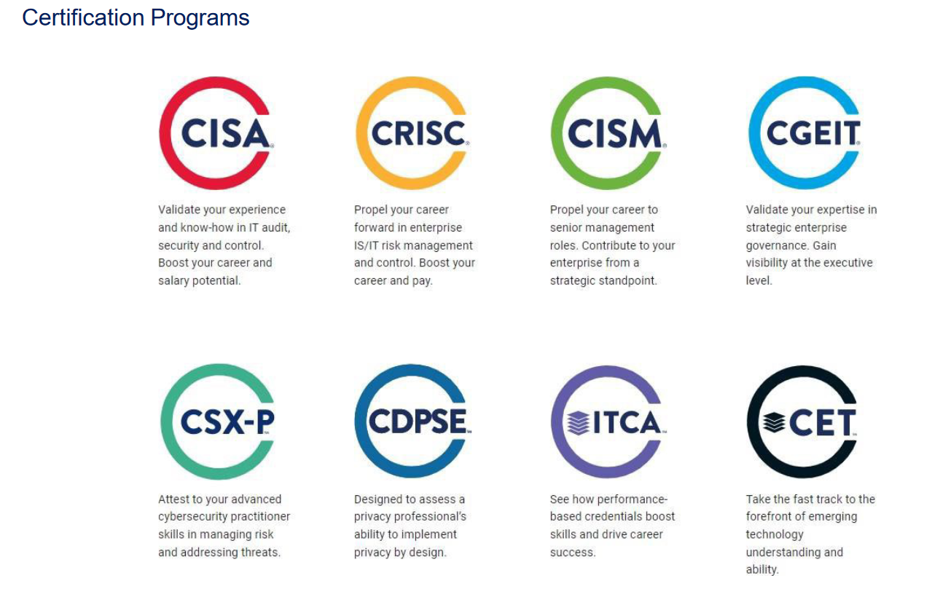
ISACA (formerly known as the Information Systems Audit and Control Association)
  administers several exam certifications, including the Certified Information Systems Auditor (CISA), the Certified in Risk and Information Systems Control (CRISC), and the Certified in the Governance of Enterprise IT (CGEIT) certifications.

Slide 5
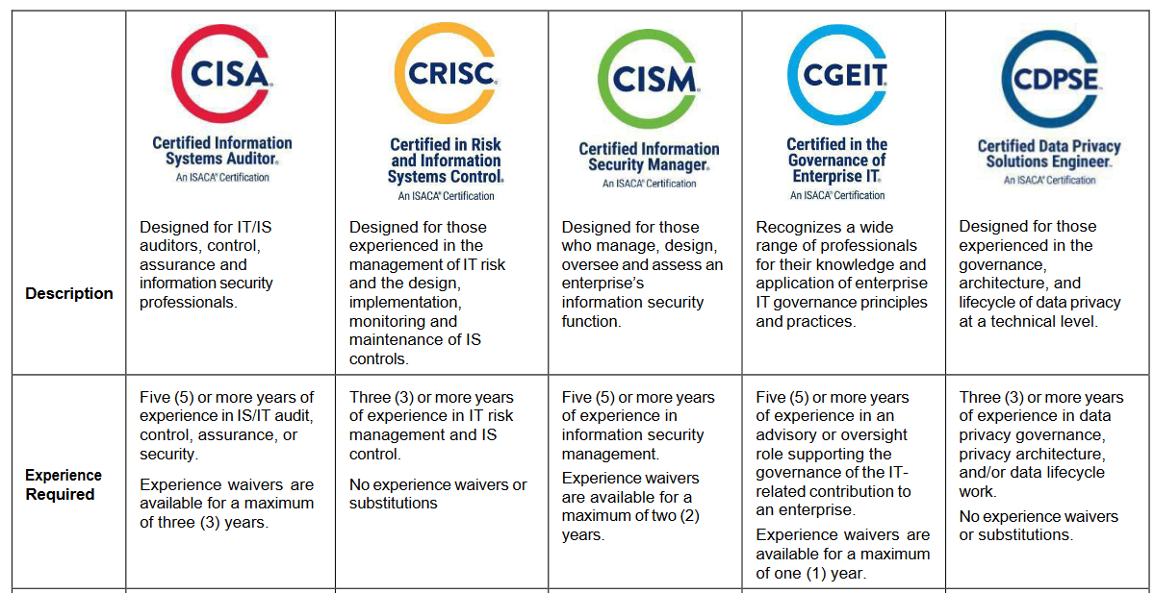

Slide 6
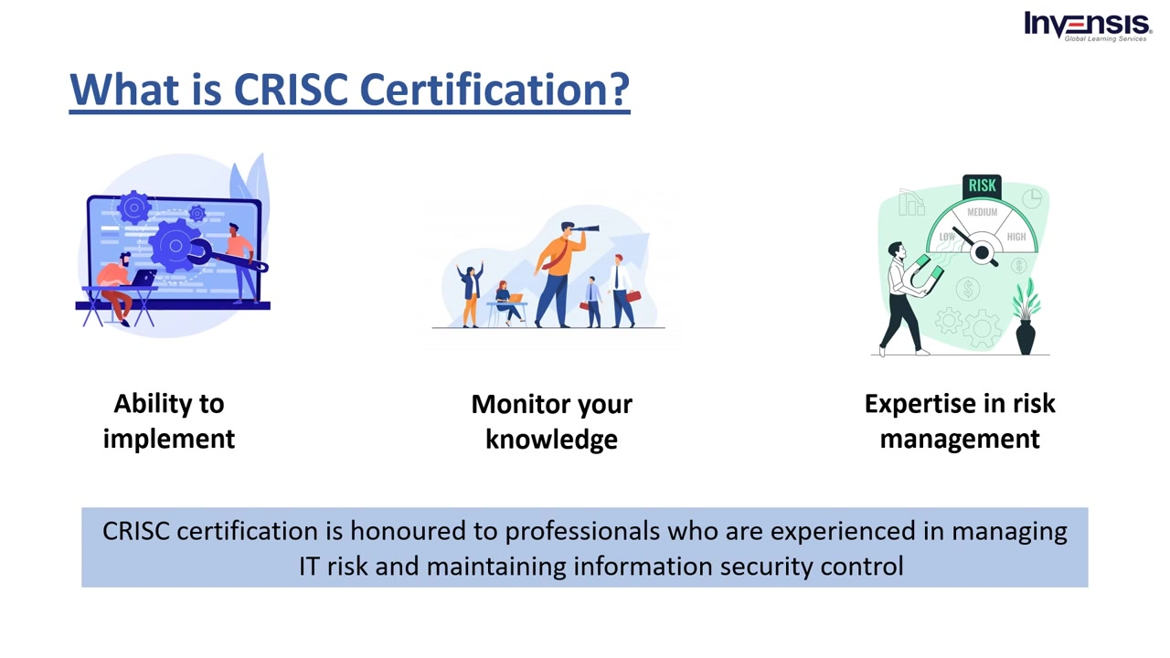

Slide 7
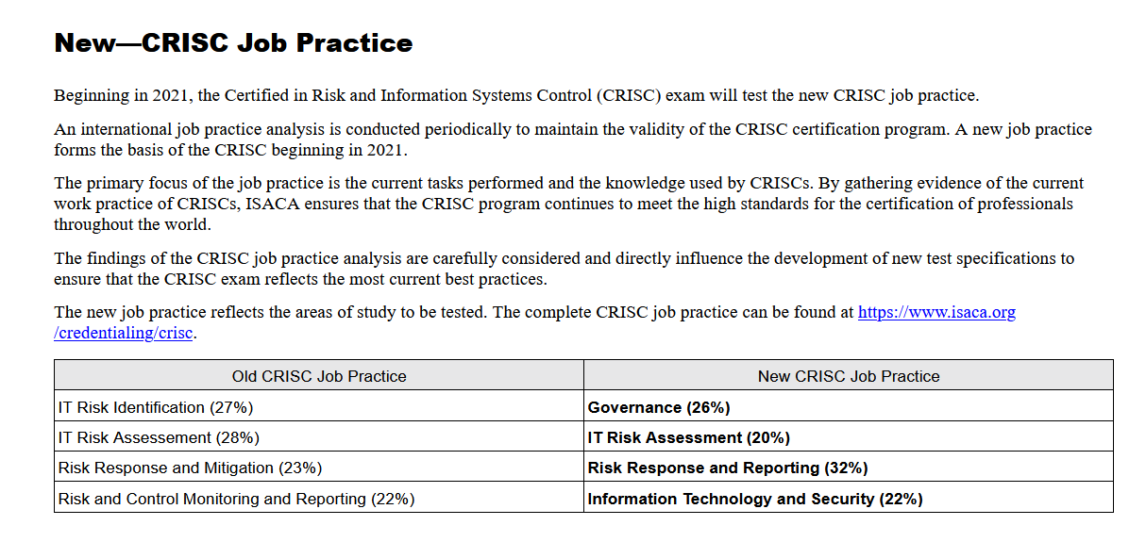

Slide 8
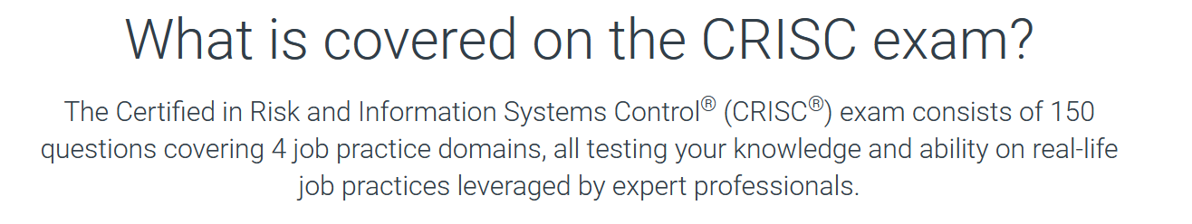
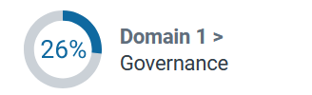
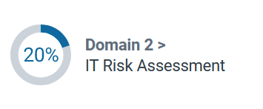
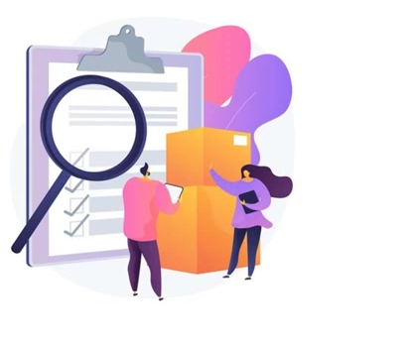
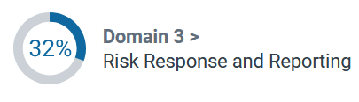
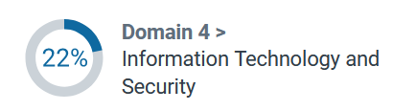

Slide 9
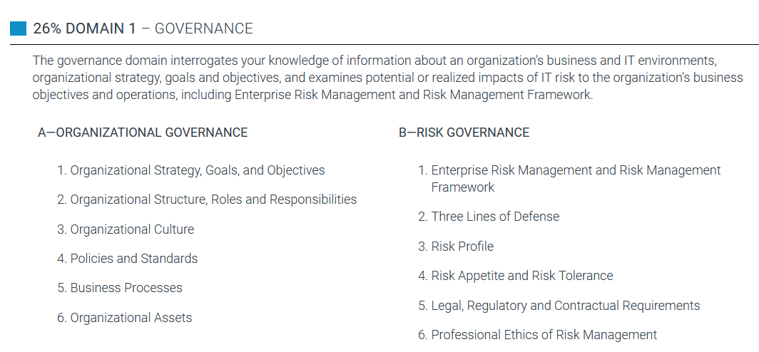


Slide 10
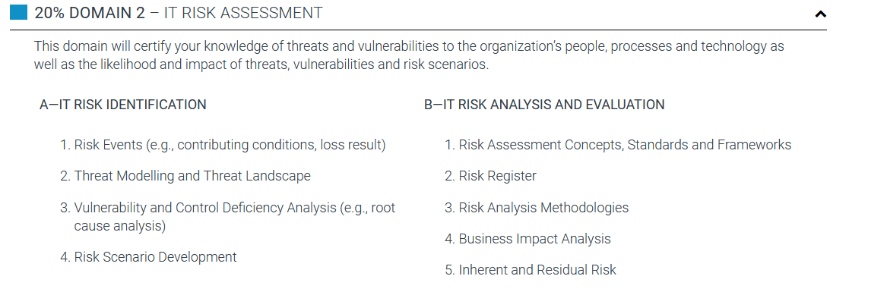


Slide 11
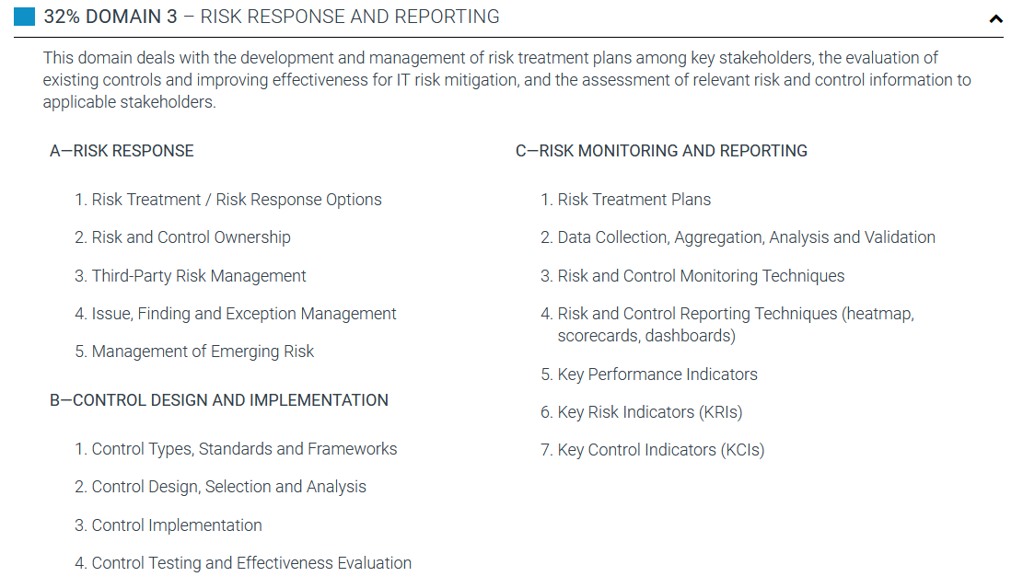


Slide 12
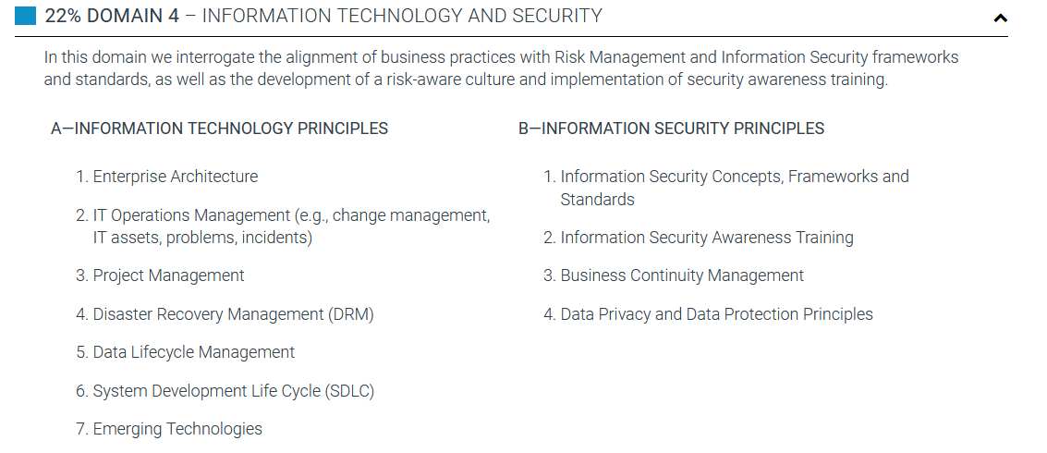


Slide 13
SUPPORTING TASKS
Collect and review existing information regarding the organization’s business and IT environments.
Identify potential or realized impacts of IT risk to the organization’s business objectives and operations.
Identify threats and vulnerabilities to the organization’s people, processes and technology.
Evaluate threats, vulnerabilities and risk to identify IT risk scenarios.
Establish accountability by assigning and validating appropriate levels of risk and control ownership.
Establish and maintain the IT risk register and incorporate it into the enterprise-wide risk profile.
Facilitate the identification of risk appetite and risk tolerance by key stakeholders.
Promote a risk-aware culture by contributing to the development and implementation of security awareness training.
Conduct a risk assessment by analyzing IT risk scenarios and determining their likelihood and impact.
Identify the current state of existing controls and evaluate their effectiveness for IT risk mitigation.
Review the results of risk analysis and control analysis to assess any gaps between current and desired states of the IT risk environment.
Facilitate the selection of recommended risk responses by key stakeholders.
Collaborate with risk owners on the development of risk treatment plans.
Collaborate with control owners on the selection, design, implementation and maintenance of controls.
Validate that risk responses have been executed according to risk treatment plans.
Define and establish key risk indicators (KRIs).
Monitor and analyze key risk indicators (KRIs).
Collaborate with control owners on the identification of key performance indicators (KPIs) and key control indicators (KCIs).
Monitor and analyze key performance indicators (KPIs) and key control indicators (KCIs).
Review the results of control assessments to determine the effectiveness and maturity of the control environment.
Report relevant risk and control information to applicable stakeholders to facilitate risk-based decision-making.
Evaluate alignment of business practices with risk management and information security frameworks and standards.

Slide 14
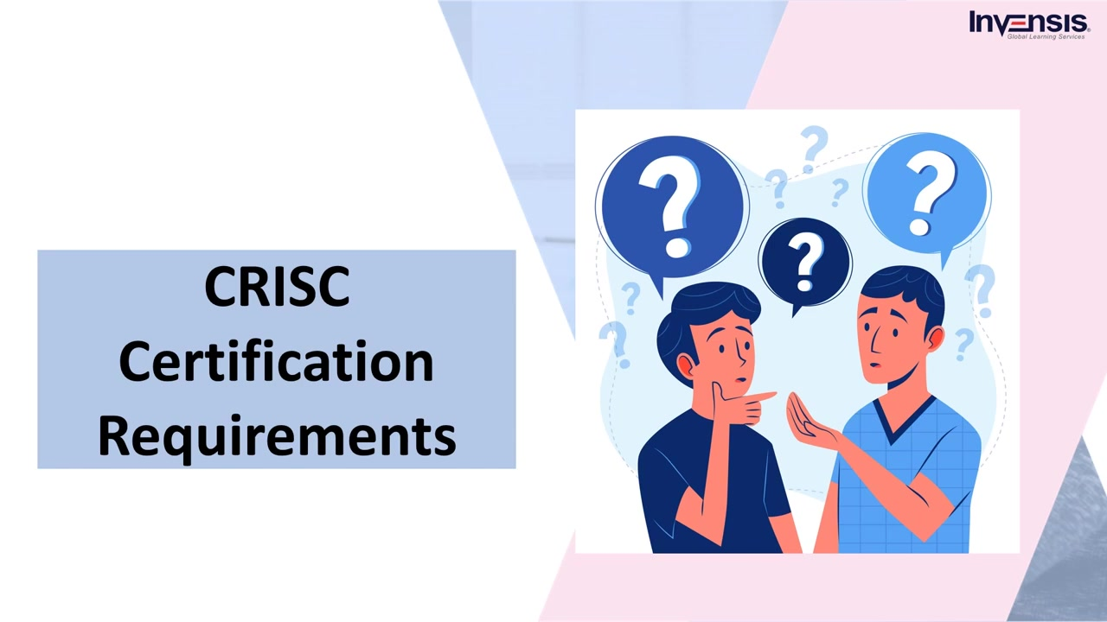

Slide 15
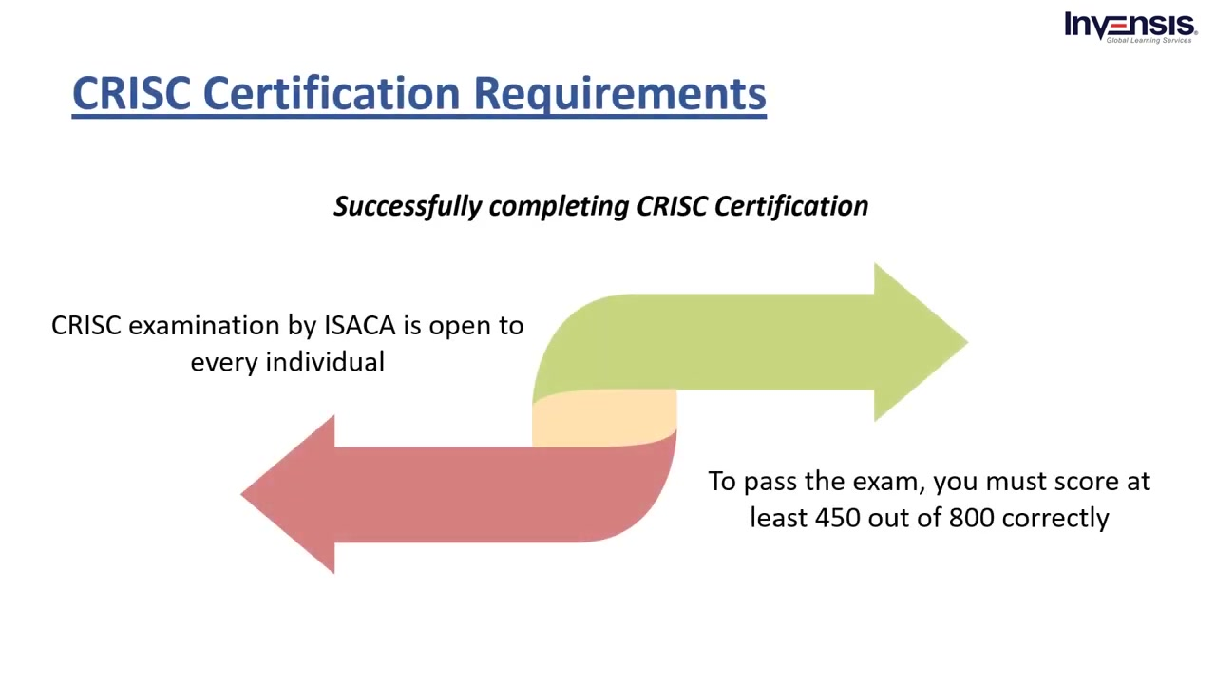

Slide 16
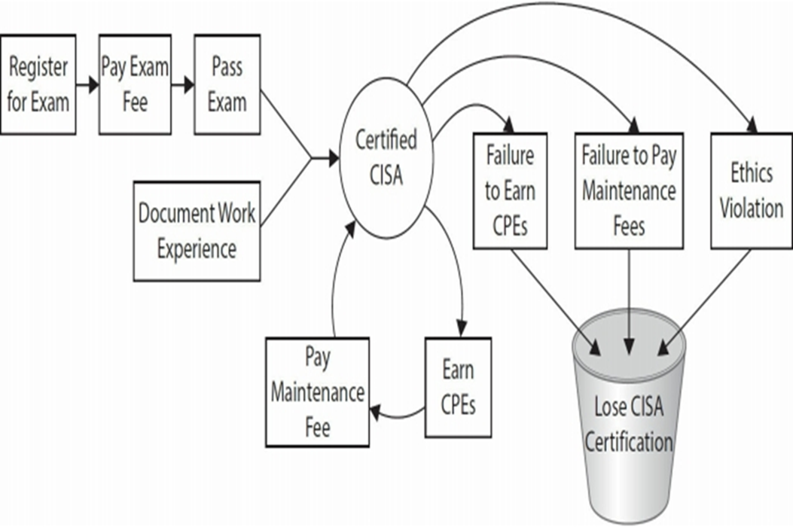
CRISC
CISM
CGEIT

Slide 17
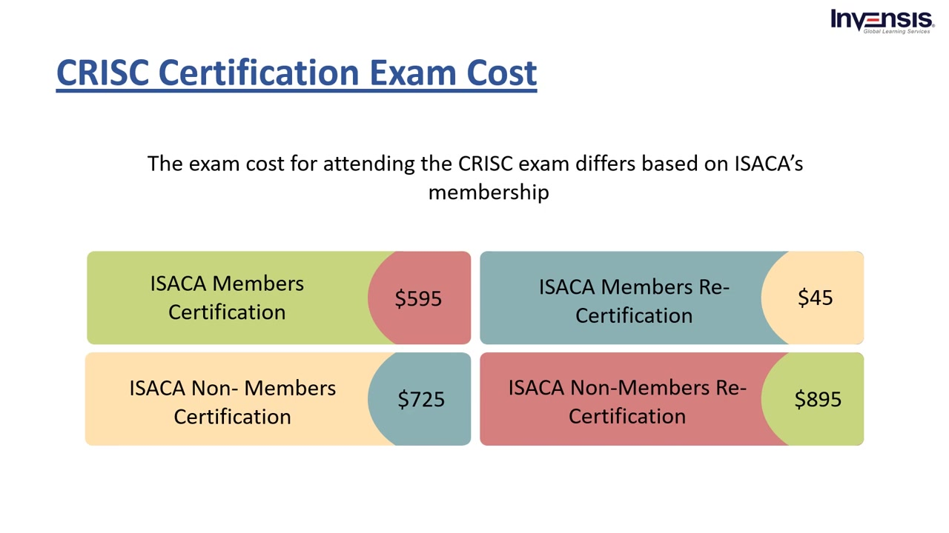

Slide 18
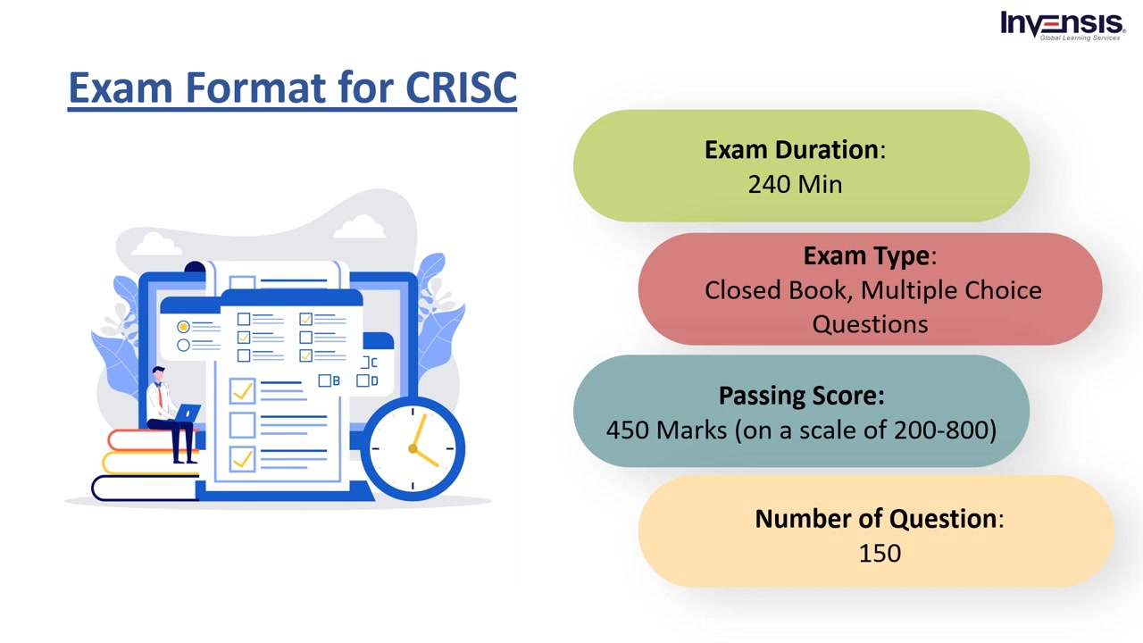

Slide 19
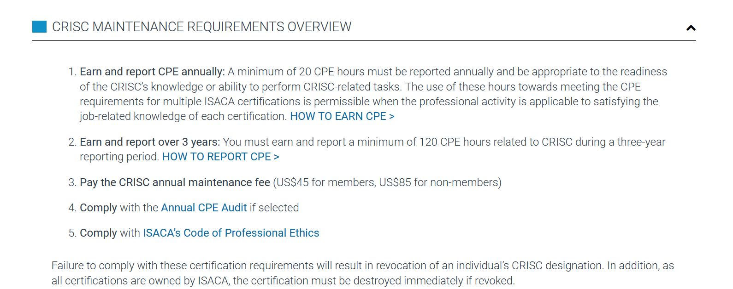

Slide 20
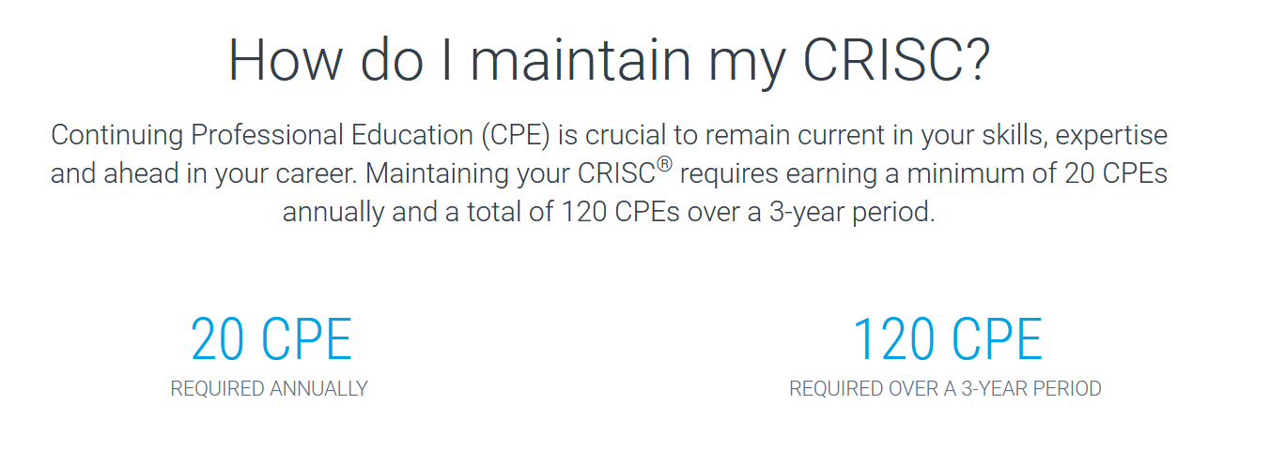
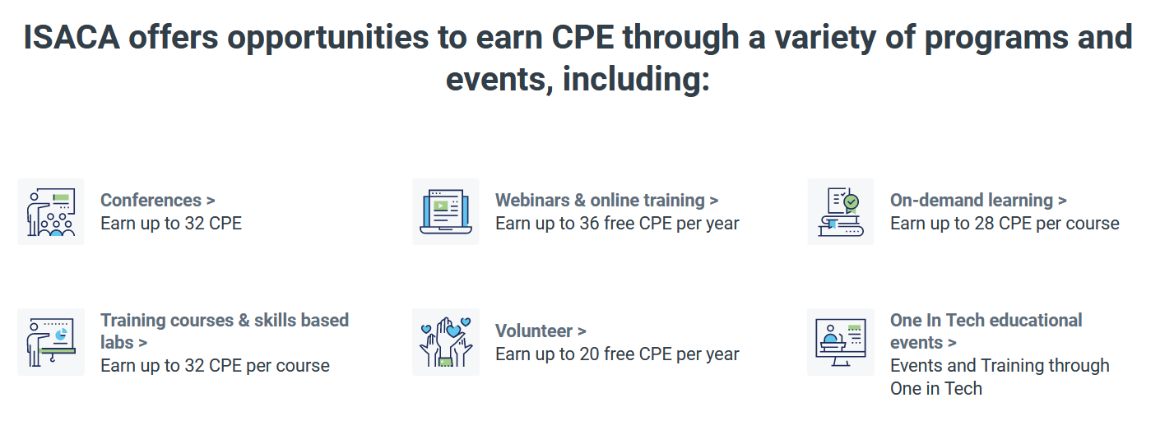

Slide 21
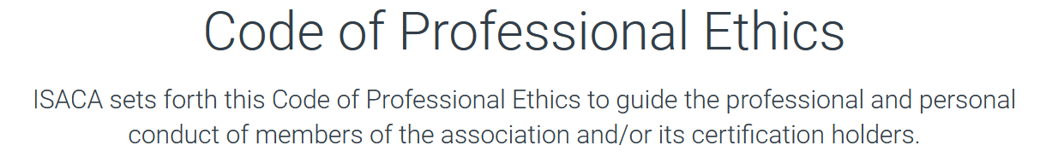
Members and ISACA certification holders shall:
Support the implementation of, and encourage compliance with, appropriate standards and procedures for the effective governance and management of enterprise information systems and technology, including: audit, control, security and risk management.
Perform their duties with objectivity, due diligence and professional care, in accordance with professional standards.
Serve in the interest of stakeholders in a lawful manner, while maintaining high standards of conduct and character, and not discrediting their profession or the Association.
Maintain the privacy and confidentiality of information obtained in the course of their activities unless disclosure is required by legal authority. Such information shall not be used for personal benefit or released to inappropriate parties.
Maintain competency in their respective fields and agree to undertake only those activities they can reasonably expect to complete with the necessary skills, knowledge and competence.
Inform appropriate parties of the results of work performed including the disclosure of all significant facts known to them that, if not disclosed, may distort the reporting of the results.
Support the professional education of stakeholders in enhancing their understanding of the governance and management of enterprise information systems and technology, including: audit, control, security and risk management.
Failure to comply with this Code of Professional Ethics can result in an investigation into a member's or certification holder's conduct and, ultimately, in disciplinary measures.

Slide 22
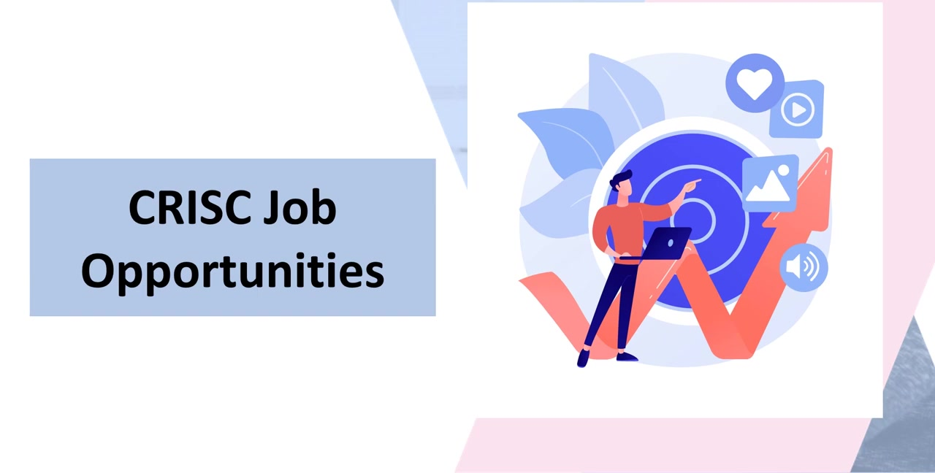

Slide 23
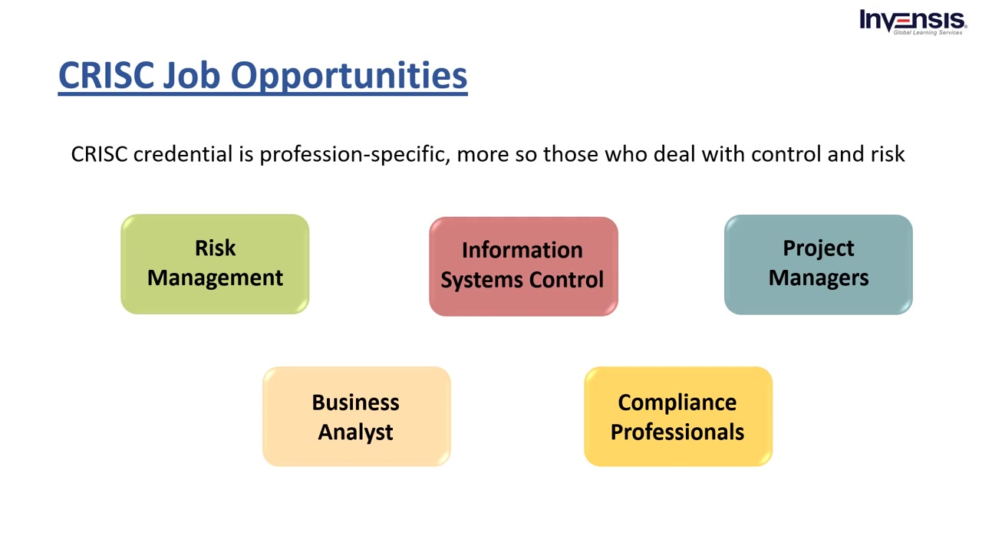

Slide 24
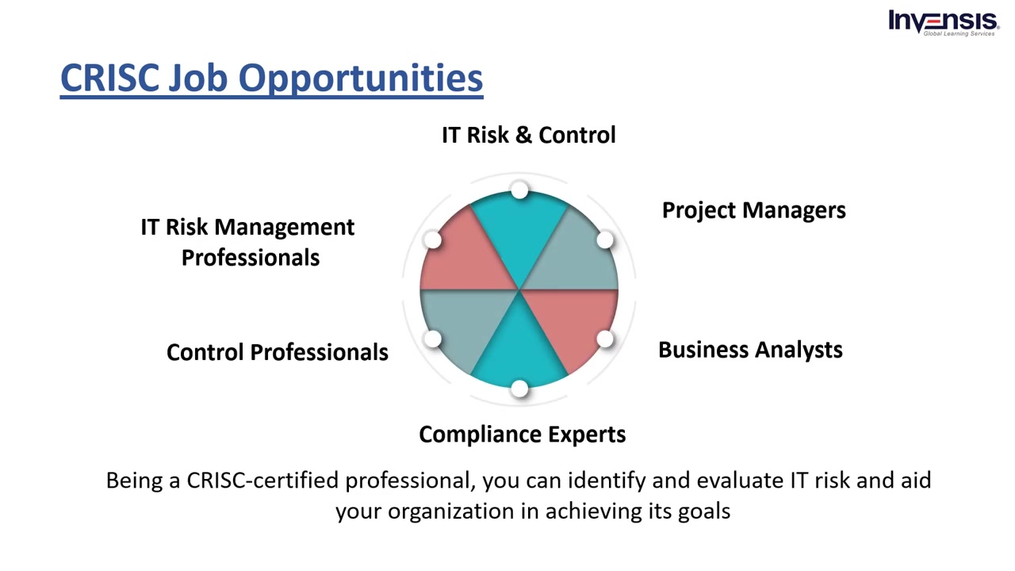

Slide 25
